Slide 1
UNIT III: User-Based collaborative filtering, Similarity Function Variants, Variants of the Prediction Function, Item-Based Collaborative filtering, Comparing User-Based and Item-Based Methods, Strengths and Weaknesses of Neighborhood-Based Methods

Slide 2
Neighborhood-Based Collaborative Filtering
Introduction
Neighborhood-based collaborative filtering (also called memory-based filtering) relies on user and item similarity.
Two main types:
User-based collaborative filtering: Predicts ratings based on similar users' ratings.
Item-based collaborative filtering: Predicts ratings based on a user's ratings of similar items.

Slide 3
Key Differences
User-based filtering: Uses peer users' ratings (rows of rating matrix).
Item-based filtering: Uses the same user's ratings on similar items (columns of rating matrix).
They are complementary but produce different recommendation types.
Problem Formulation
Predicting missing ratings: Estimate the unknown rating for a user-item pair.
Finding top-k items or users:
More practical in real-world applications (e.g., recommending top-k items to users).
Top-k users can help merchants with targeted marketing.

Slide 4
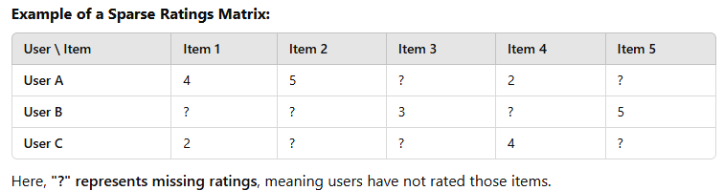
Key Properties of Ratings Matrices
1. Definition and Structure of Ratings Matrices
The ratings matrix R is an m × n matrix where m represents users and n represents items.
Ratings are typically sparse, with only a small subset of the entries specified.
Specified entries = Training data; Unspecified entries = Test data.
Recommendation is a generalization of classification and regression problems.

Slide 5
2. Types of Ratings
Continuous Ratings
Ratings can take any value within a range (e.g., Jester joke system: -10 to 10).
Drawback: Users find it difficult to choose from an infinite set of values.
Interval-Based Ratings
Ratings are selected from a fixed scale (e.g., 1-5, -2 to 2, 1-7).
Assumes equal distance between rating levels.
Ordinal Ratings
Categorical but ordered values (e.g., “Strongly Disagree” to “Strongly Agree”).
No assumption that differences between categories are equal

Slide 6
Forced choice method: Omits neutral options to ensure decisive responses.
Binary Ratings
Only two options (e.g., Like/Dislike, Thumbs up/Thumbs down).
Found in systems like Pandora Radio.
Forced choice is imposed, as users cannot express neutrality.
Unary Ratings
Users express only positive preferences (e.g., Facebook "Like").
Often derived from implicit feedback (e.g., purchasing an item implies a positive rating).
No explicit negative feedback option.

Slide 7
3. Implicit Feedback & Unary Ratings
Implicit feedback: User actions (e.g., purchases, clicks) are interpreted as preferences.
More common than explicit ratings, as users interact more frequently than they rate.
Can be seen as a positive-unlabeled (PU) learning problem in classification.
4. The Long-Tail Property in Ratings Distribution
Observation: A small fraction of items are rated frequently (popular items), while the majority have few ratings (long-tail items).
Graph representation:
X-axis: Items ranked by frequency of ratings.
Y-axis: Number of ratings per item.
Results in a skewed distribution.

Slide 8
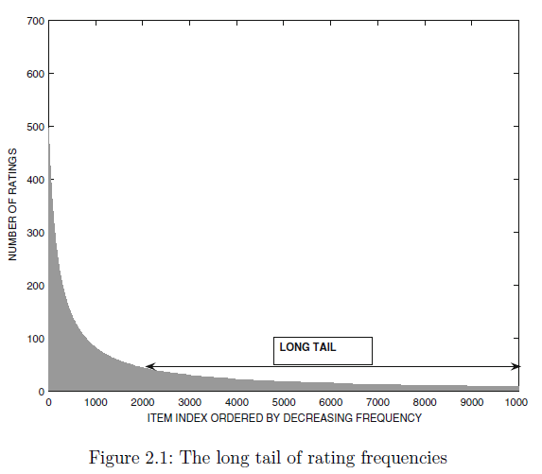
5. Implications of the Long-Tail Property
Merchant Profitability
Popular items are competitive but low-profit.
Less popular items (long-tail) often have higher profit margins (e.g., Amazon’s strategy).

Slide 9
Difficulty in Long-Tail Predictions
Sparse ratings in the long tail make predictions less accurate.
Many recommendation algorithms favor popular items, reducing diversity.
Impact on Neighborhood-Based Filtering
High-frequency items define neighborhoods, leading to biased predictions.
Frequent items do not always represent rare items, causing misleading recommendations.
Evaluation metrics may also become misleading due to this bias.

Slide 10
Predicting Ratings with Neighborhood-Based Methods
1. Concept of Neighborhood-Based Methods
Uses user-user similarity or item-item similarity to make recommendations.
Relies on the principle that similar users or similar items have similar ratings.
2. Two Basic Principles
User-Based Models
Users with similar rating patterns tend to rate items similarly.
Example: If Alice and Bob have rated movies similarly in the past, Alice’s rating for "Terminator" can predict Bob’s rating for the same movie.

Slide 11
Item-Based Models
Similar items receive similar ratings from the same user.
Example: Bob's ratings for "Alien" and "Predator" can predict his rating for "Terminator."
3. Connection to Nearest Neighbor Classification
Collaborative filtering is a generalization of classification/regression modeling.
Neighborhood-based models are similar to nearest neighbor classifiers in machine learning.
Unlike classification, collaborative filtering determines nearest neighbors using both rows (users) and columns (items).

Slide 12
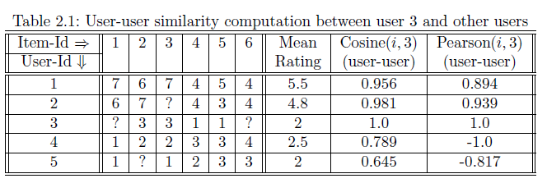
4. User-User Similarity Computation (Example from Table 2.1)
User similarity measures:
Cosine similarity
Pearson correlation
Users with higher similarity scores are considered closer neighbors.

Slide 13
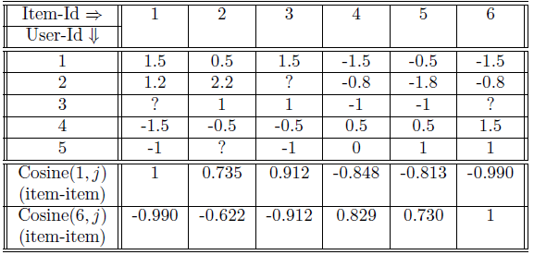
5. Item-Item Similarity Computation (Example from Table 2.2)
Adjusted cosine similarity is used for item similarity calculations.
Items are compared after mean-centering ratings to eliminate user bias.
Cosine similarity scores between items indicate their similarity levels.

Slide 14
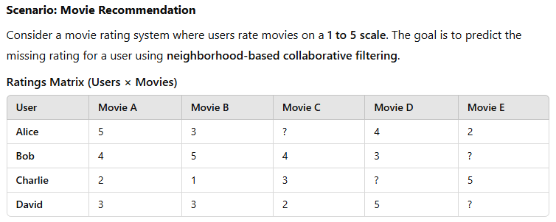
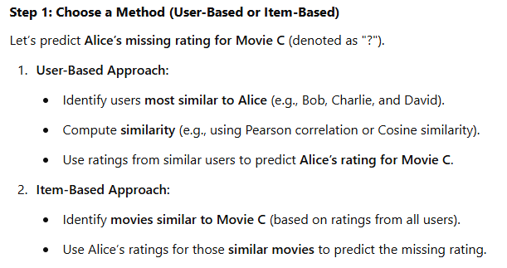

Slide 15
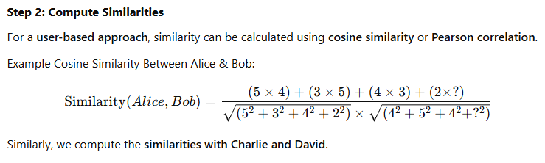
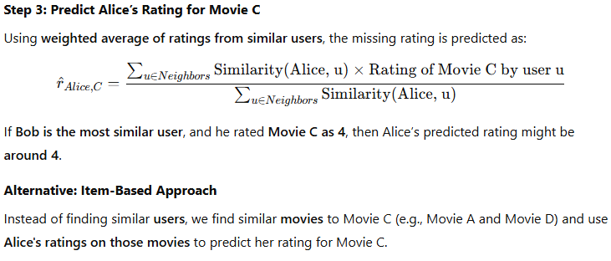
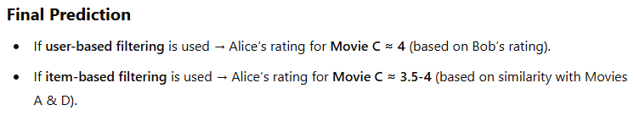

Slide 16
User-Based Neighborhood Models
1. Concept of User-Based Neighborhoods
Defines user neighborhoods by identifying similar users to the target user.
Uses these similar users' ratings to predict missing ratings for the target user.
A similarity function is required, but it must account for different rating scales among users.
2. Key Challenges in User-Based Similarity Computation
Different rating scales: Some users consistently give higher or lower ratings than others.
Sparse ratings: Many users rate only a small subset of items, making similarity computation challenging.
Mutual rating sets: Similarity is computed only for the overlapping rated items between two users.

Slide 17

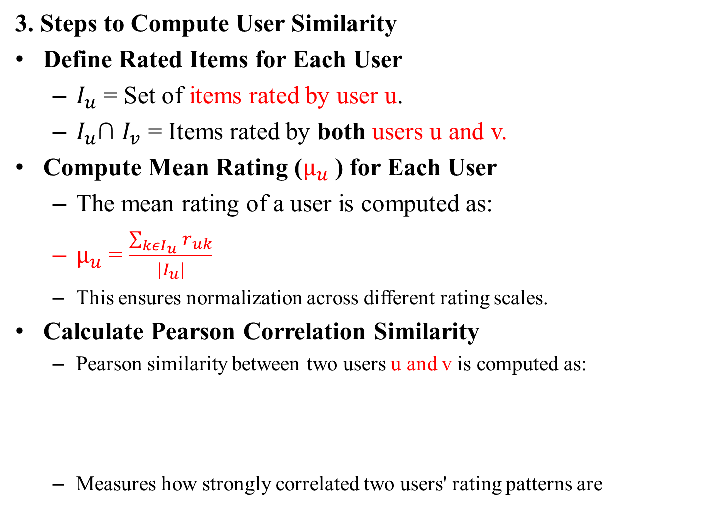
3. Steps to Compute User Similarity
Define Rated Items for Each User
$I_{u}$​ = Set of items rated by user u.
$I_{u}$∩ $I_{v}$​ = Items rated by both users u and v.
Compute Mean Rating ($µ_{u}$ ​) for Each User
The mean rating of a user is computed as:
$µ_{u}$ = $\frac{\sum_{kεI_{u}}{r_{uk}}}{|I_{u}|}$
This ensures normalization across different rating scales.
Calculate Pearson Correlation Similarity
Pearson similarity between two users u and v is computed as:
Measures how strongly correlated two users' rating patterns are

Slide 18

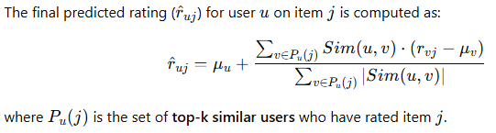
Find Top-k Similar Users for Each Item Prediction
The k most similar users who have rated the target item are selected.
Users with negative or very low similarity may be excluded for better predictions.
4. Predicting Missing Ratings Using Neighborhood-Based Approach
Ratings need to be mean-centered to avoid bias from different rating scales:

Slide 19
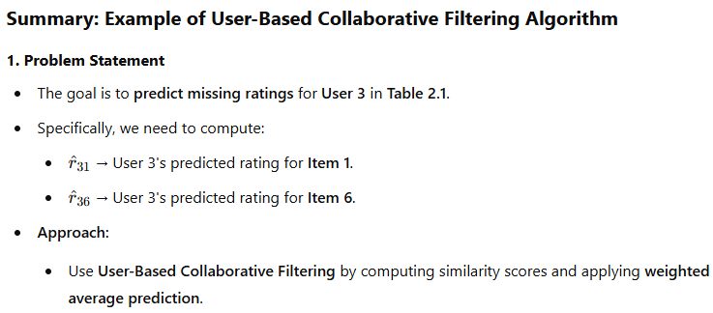
5. Variations & Enhancements
Some implementations compute mean ratings dynamically based on overlapping items.
Heuristic filtering removes users with low or negative similarity to improve accuracy.
The method allows for different similarity measures and weighting strategies to fine-tune recommendations.

Slide 20
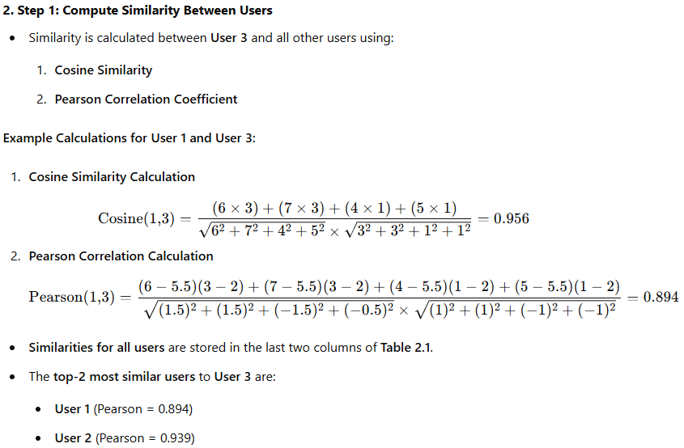

Slide 21
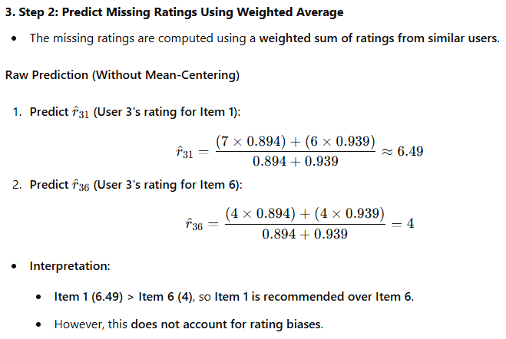

Slide 22
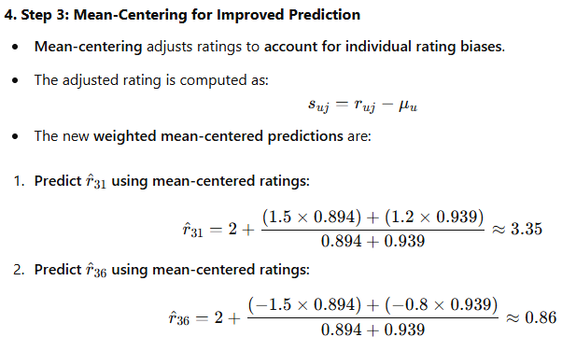
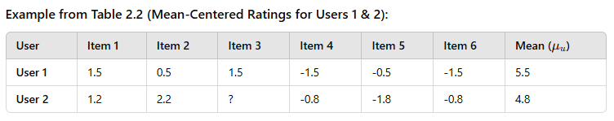

Slide 23
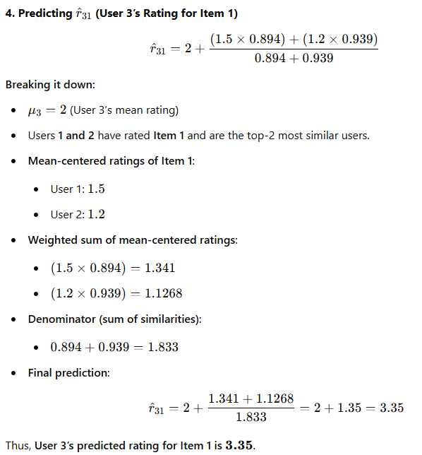
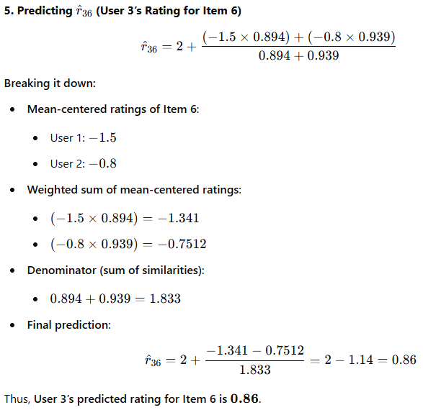

Slide 24
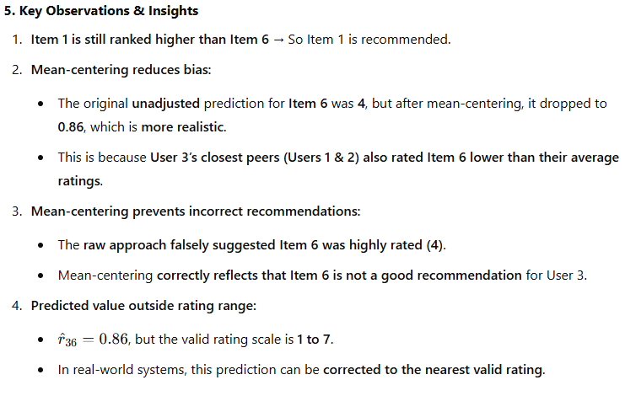

Slide 25


Similarity Function Variants
Raw Cosine Similarity
Computes similarity using raw ratings instead of mean-centered ratings.
Formula (Mutually Rated Items Only):
Alternative Formula (All Rated Items Used for Normalization):

Slide 26
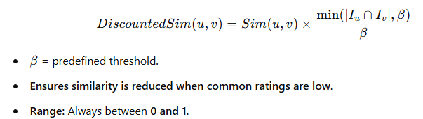
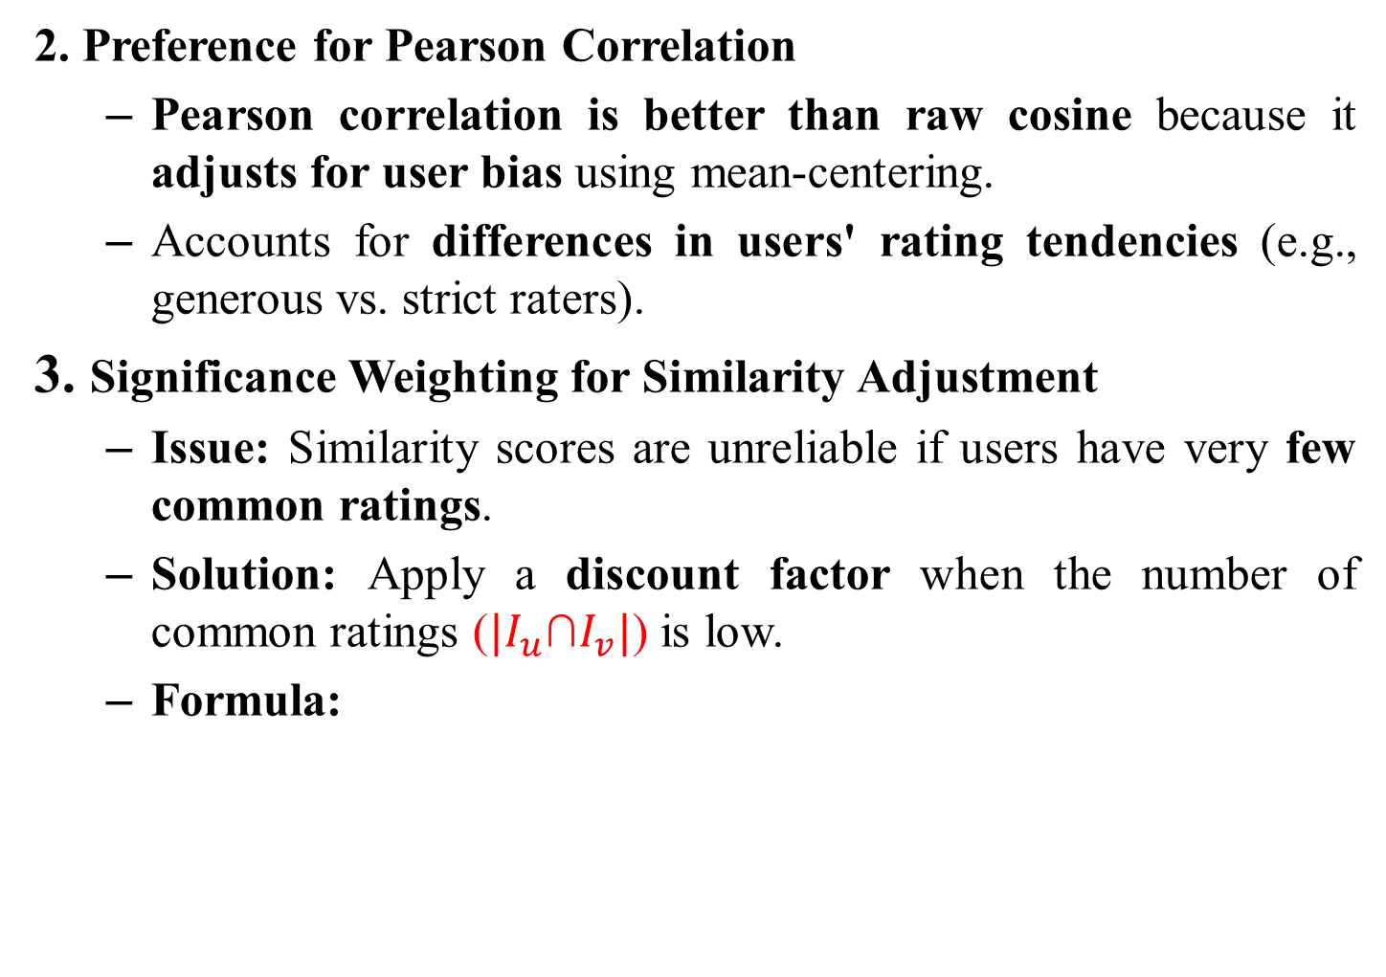
2. Preference for Pearson Correlation
Pearson correlation is better than raw cosine because it adjusts for user bias using mean-centering.
Accounts for differences in users' rating tendencies (e.g., generous vs. strict raters).
3. Significance Weighting for Similarity Adjustment
Issue: Similarity scores are unreliable if users have very few common ratings.
Solution: Apply a discount factor when the number of common ratings (${|I}_{u}$∩$I_{v}|$) is low.
Formula:

Slide 27
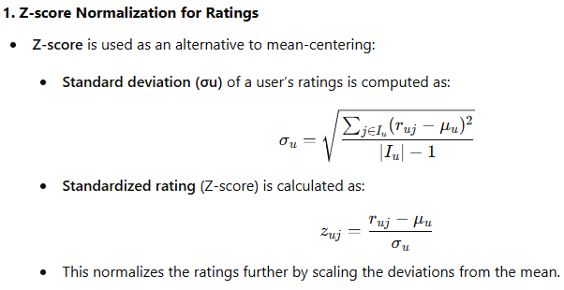
4. Usage of Discounted Similarity
Used in:
Selecting peer groups for recommendations.
Computing weighted predictions for missing ratings.
Variants of the Prediction Function

Slide 28
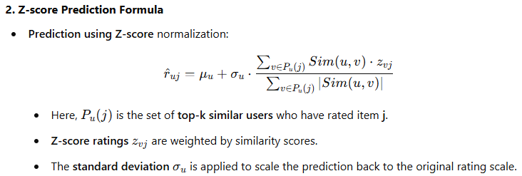
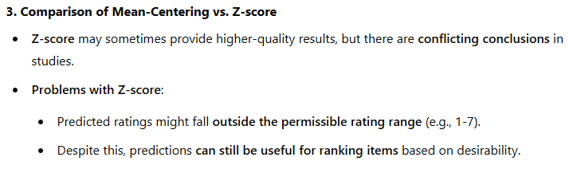

Slide 29
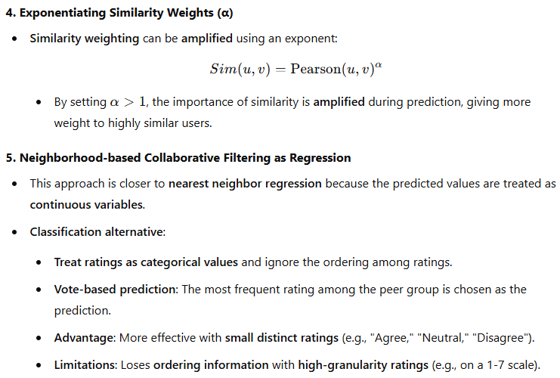

Slide 30
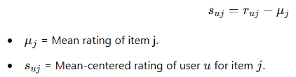
Item-Based Neighborhood Models
1. Concept of Item-Based Neighborhood Models
Instead of finding similar users, this model finds similar items.
Similarity is computed between items (columns in the ratings matrix) rather than users.
Each row is mean-centered before computing similarities.
2. Mean-Centering Process
Similar to user-based filtering, but performed column-wise (on items).
The average rating of each item is subtracted from individual ratings:

Slide 31
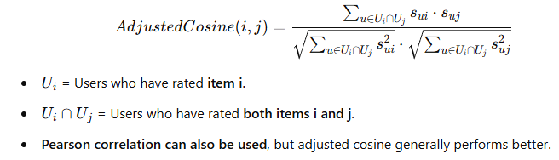
3. Adjusted Cosine Similarity for Items
Adjusts cosine similarity by mean-centering ratings before computing similarity.
Formula:
4. Predicting Missing Ratings
To predict user u's rating for item t:
Find the top-k most similar items to item t.
Select only the items that user u has rated.
Compute a weighted average of user u's ratings on these similar items.

Slide 32
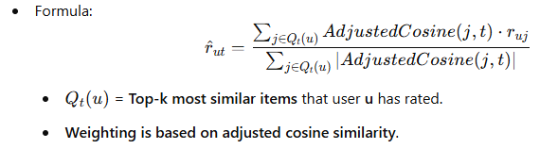
5. Example: Movie Recommendation
If a user has rated several sci-fi movies, the model can predict their rating for another similar sci-fi movie.
Item similarity ensures recommendations align with the user's interests and rating patterns.

Slide 33
6. Similarities to User-Based Models
Same core structure, but items replace users in the similarity computation.
Variants of similarity and prediction functions (like Z-score and weighting adjustments) can also be applied to item-based filtering.
Example: Item-Based Collaborative Filtering Algorithm
Item-Based Collaborative Filtering predicts missing ratings for User 3 using Table 2.1 and its mean-centered form (Table 2.2).
1. Problem Setup
User 3 has missing ratings for Item 1 and Item 6.
We need to predict these missing ratings using item-based collaborative filtering.

Slide 34

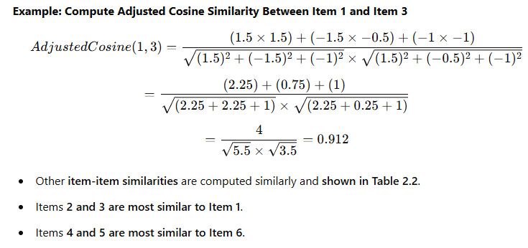
2. Compute Adjusted Cosine Similarity Between Items
Similarity between items is computed after mean-centering.
The mean-centered ratings matrix is given in Table 2.2.
Adjusted Cosine Similarity Formula:

Slide 35
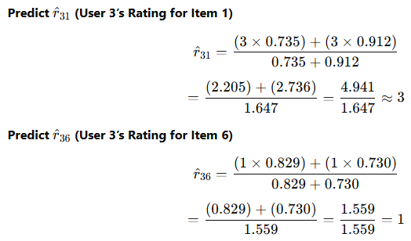
3. Predicting User 3’s Missing Ratings
Predictions are made by taking a weighted average of User 3’s ratings on the most similar items.
4. Key Observations
Item-Based Filtering Predicts:
Item 1 → Rating 3
Item 6 → Rating 1

Slide 36
Comparison with User-Based Filtering:
User-Based Prediction for Item 6 was 0.86, which was out of the valid range.
Item-Based Prediction for Item 6 is 1, which is within the allowed range.
Item-Based Filtering uses User 3’s own ratings, so predictions align better with her past ratings.
Item-Based Filtering Improves Stability:
Item similarities remain more stable over time than user similarities.
This leads to better prediction accuracy in many cases.
Even though the top-k recommended items are similar, the predicted ratings can differ.

Slide 37
Comparing User-Based and Item-Based Methods
1. Accuracy Comparison
Item-Based Methods often provide more accurate recommendations because they use a user’s own past ratings to predict new ratings.
User-Based Methods rely on other users’ ratings, which might introduce bias due to different interests.
Item-based filtering works well when similar items can be clearly identified (e.g., recommending historical movies based on past historical movies).
2. Robustness to Shilling Attacks
Item-Based Methods are more resistant to shilling attacks (fake user profiles attempting to manipulate recommendations).
User-Based Methods are more vulnerable to such attacks.

Slide 38
3. Diversity in Recommendations
User-Based Methods tend to provide more diverse recommendations than item-based methods.
Diversity ensures:
Users do not receive overly similar recommendations.
They discover new and unexpected items (serendipity).
Item-Based Methods sometimes recommend obvious choices or items too similar to what the user has already consumed.
4. Explanation of Recommendations
Item-Based Filtering allows for clear explanations, e.g.,
"Because you watched X, we recommend Y." (like Netflix does).

Slide 39
User-Based Filtering explanations are harder:
Example: A histogram of neighboring users’ ratings can be shown to explain why a movie is recommended.
However, these anonymous neighbors are not personally known to the user, reducing trust in the explanation.
5. Stability of Recommendations
Item-Based Recommendations are More Stable because:
Fewer items exist than users, making item similarity calculations more reliable.
User-Based Methods are sensitive to new ratings, as a few new ratings can change similarity scores significantly.
User-Based Methods require frequent updates due to the continuous addition of new users.
Item-Based Models need less frequent updates because items are added at a much slower rate than users.

